Slide 1

Toolkit Doc1 Overview
April 7, 2010

Slide 2
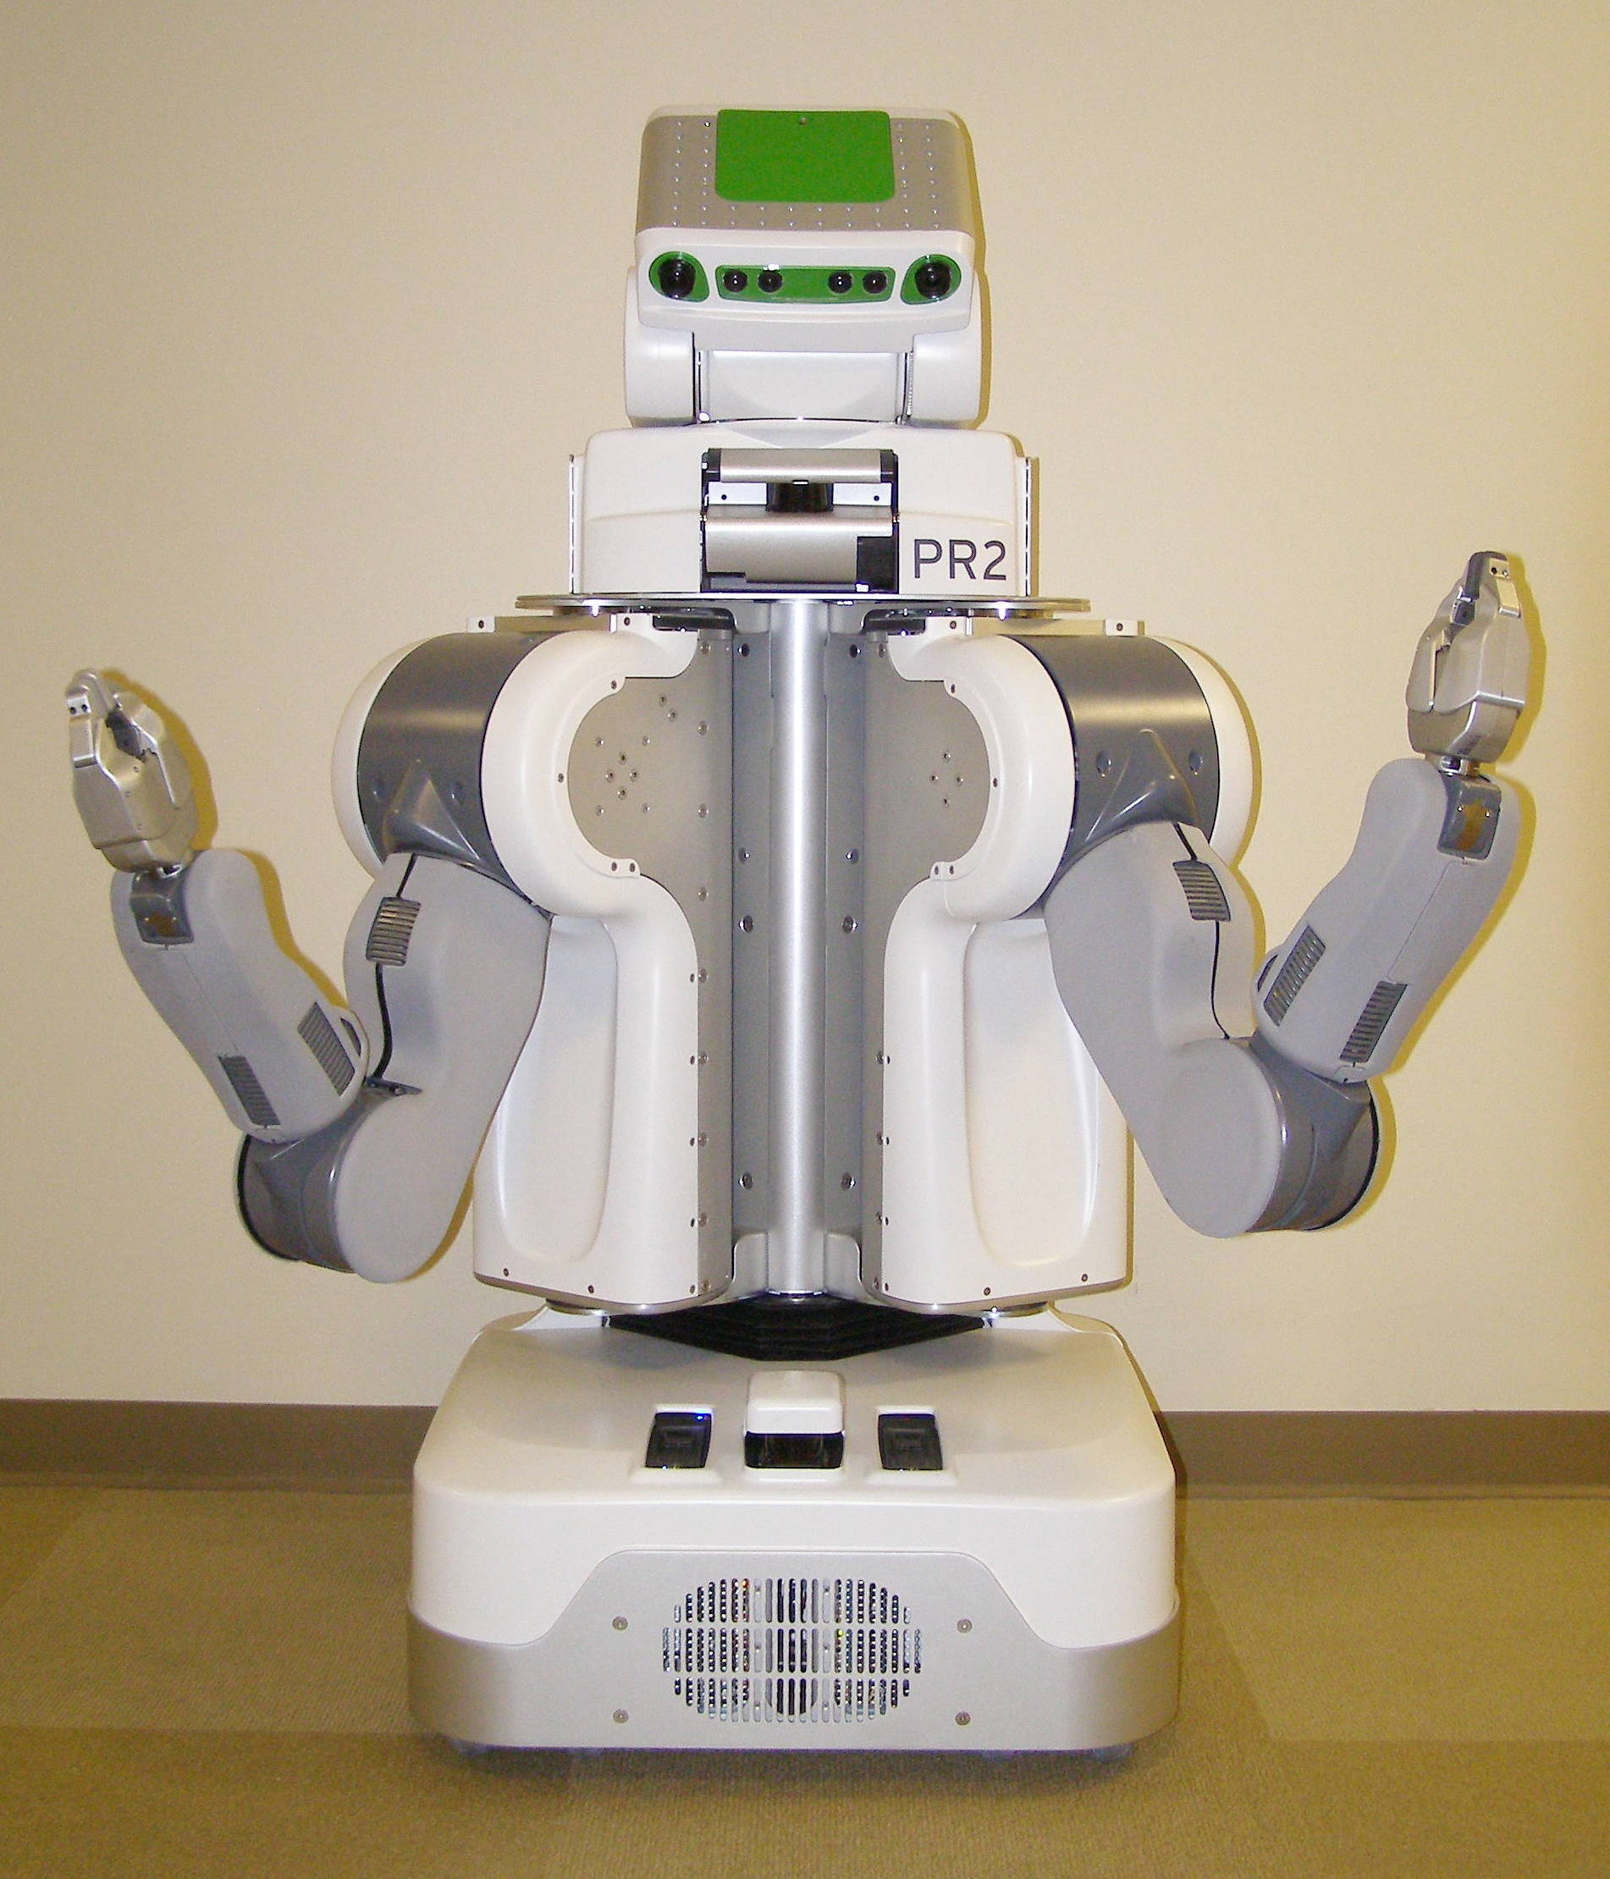
Robot Overview
Front View
Head Tilt Stage Panels
Top Front Panel
Laser Sled
Head Pan Stage Panels
Center Trim
Gripper
Shoulder Covers
Fore Arm
Upper Arm
Front Bellows
Front Bottom Panel
Base Skirt Front

Slide 3
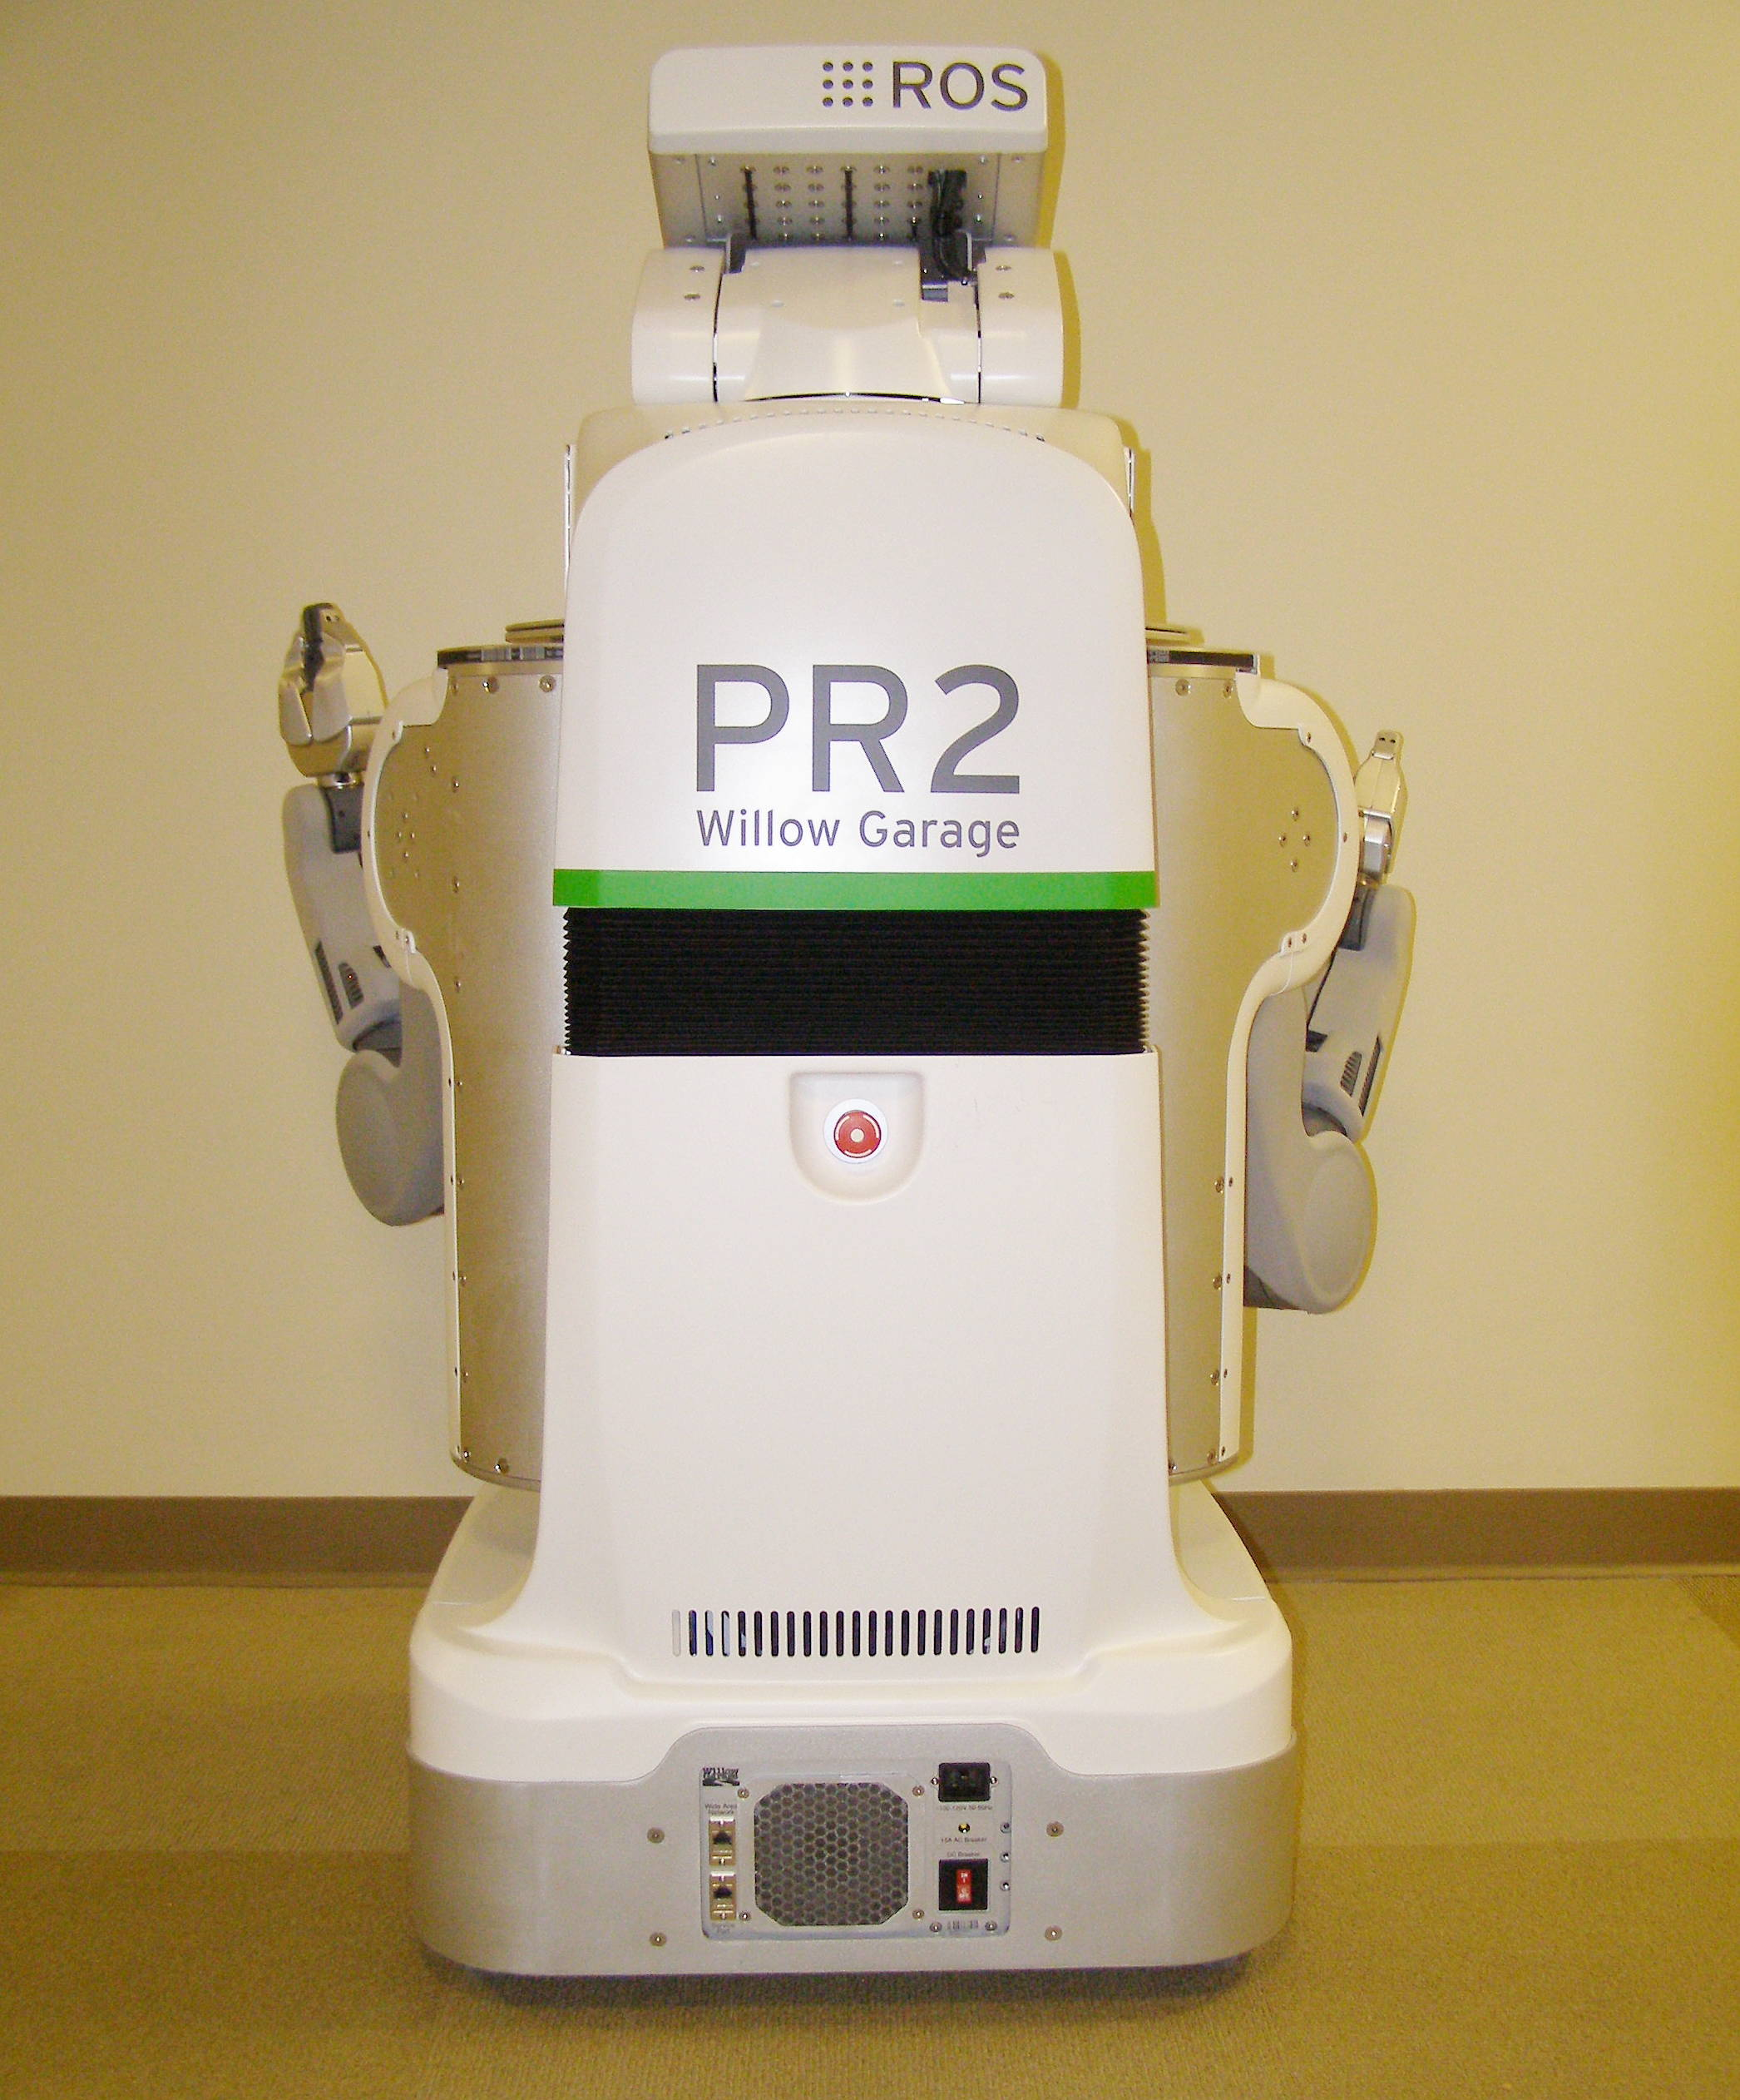
Robot Overview
Rear View
Head Tilt Stage Panel
Head Pan Stage Panel
Rear Top Panel
Rear Bellows
Rear Bottom Panel
Run – Stop
Button
Base Skirt Rear
DC Breaker
Fan Filter

Slide 4
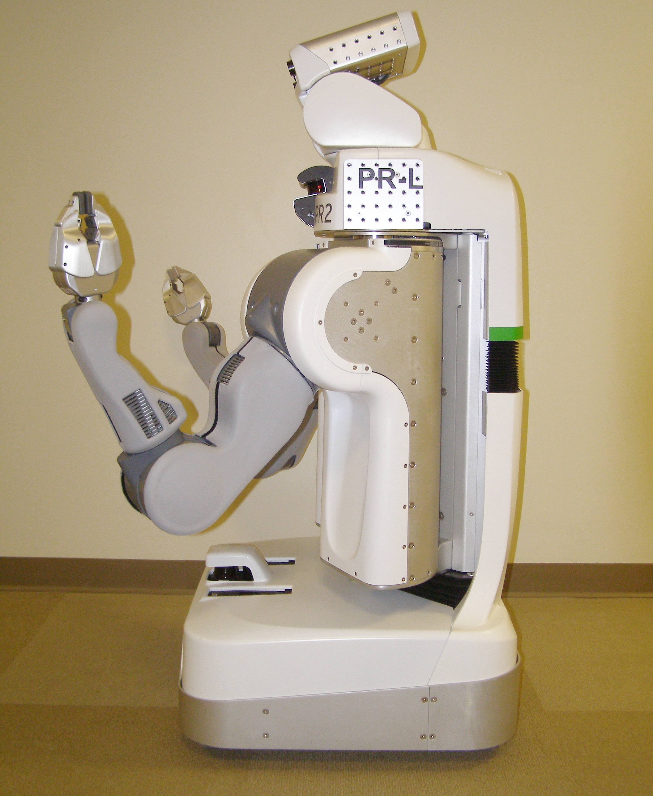
Robot Overview
Side View
Head Tilt Stage Panels
Head Pan Stage Panels
Laser Sled
Gripper
Top Front Panel
Rear Top Panel
Shoulder Covers
Rear Bellows
Rear Bottom Panel
Fore Arm
Left Body Trim
Upper Arm
Hokuyo
Front Bottom Panel
Front Bellows
Base Skirt Front
Base Skirt Rear

Slide 5
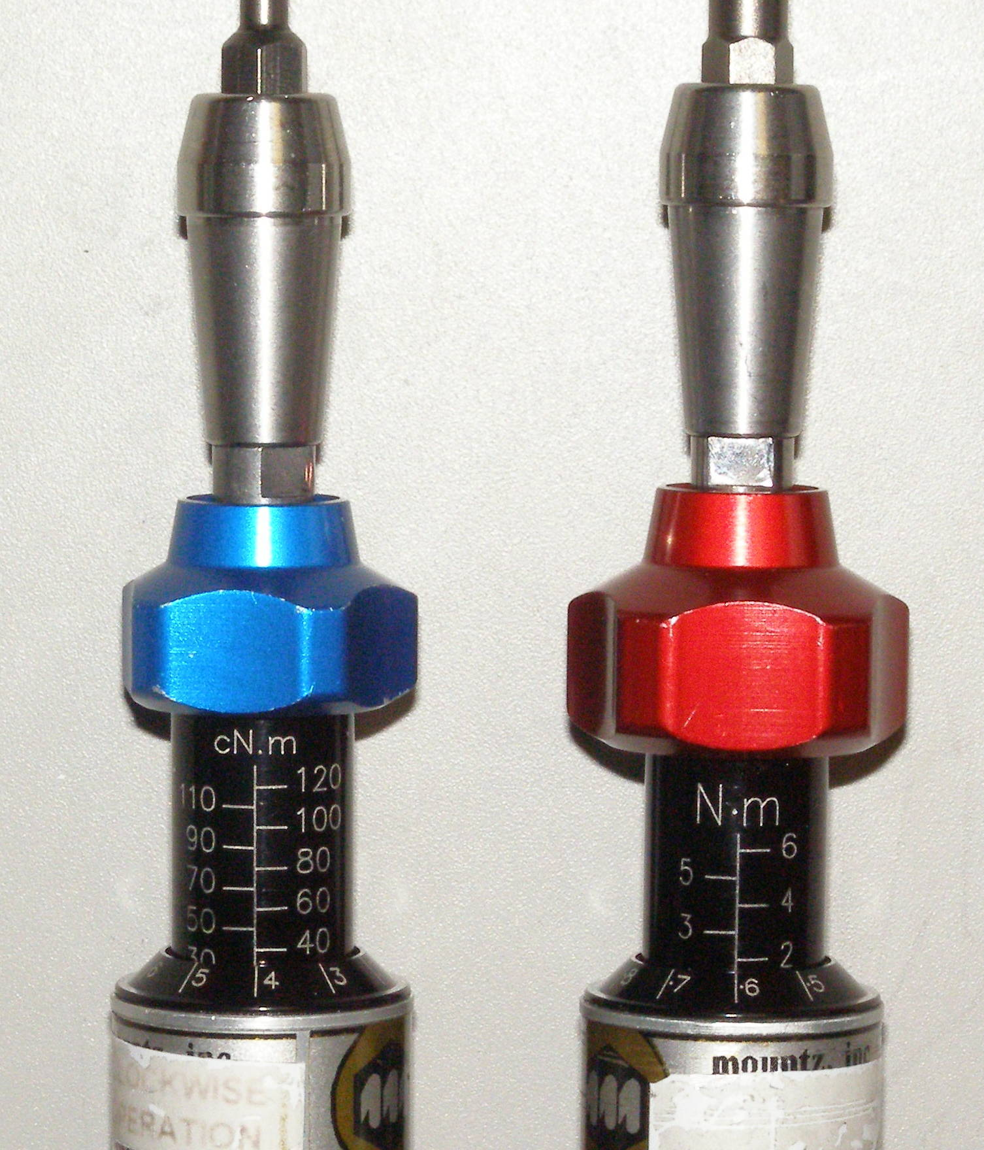
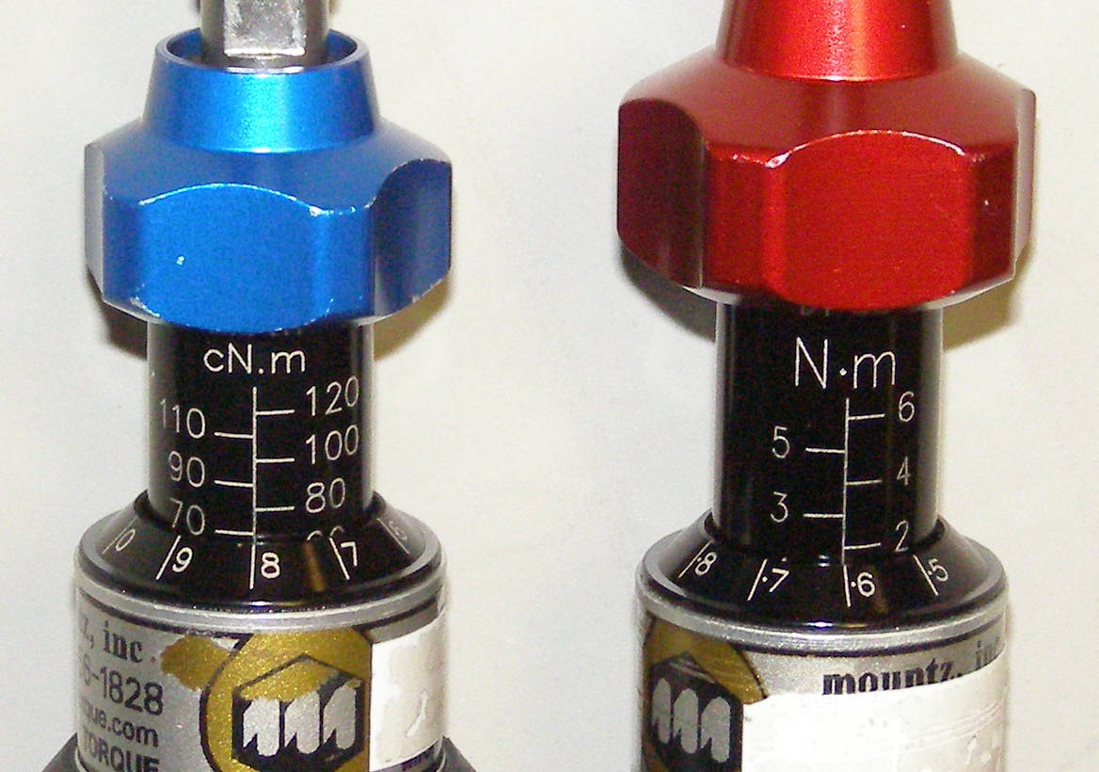
Robot Overview
Torque Drivers
Blue Adjustment Nob – Small Torque Driver
Red Adjustment Nob – Large Torque Driver
To unlock Driver
and enable torque adjustment
0.34 Nm
1.36 Nm
Rotate to adjust torque
0.68 Nm
1.58 Nm

Slide 6
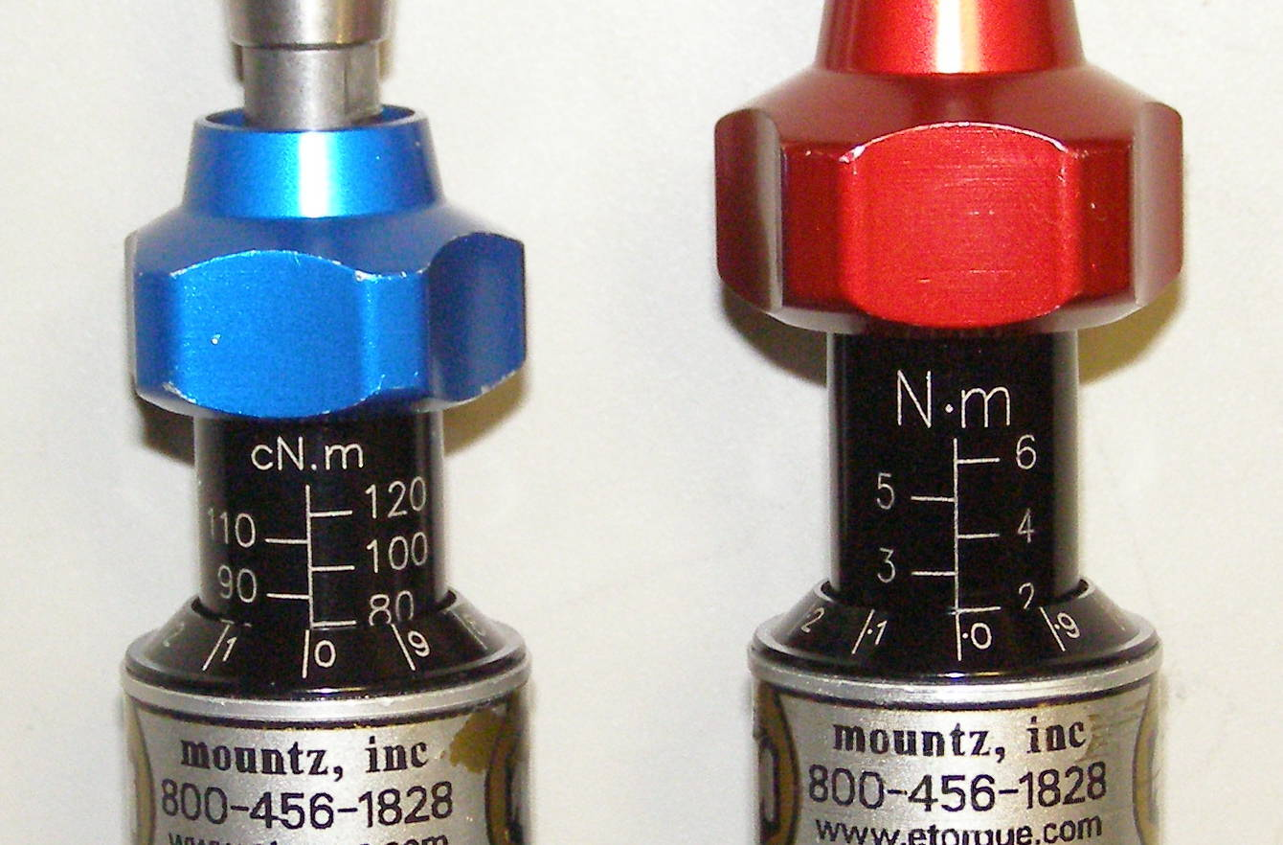
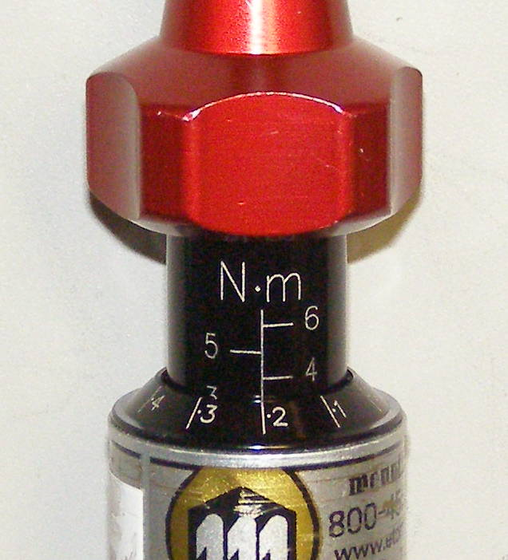
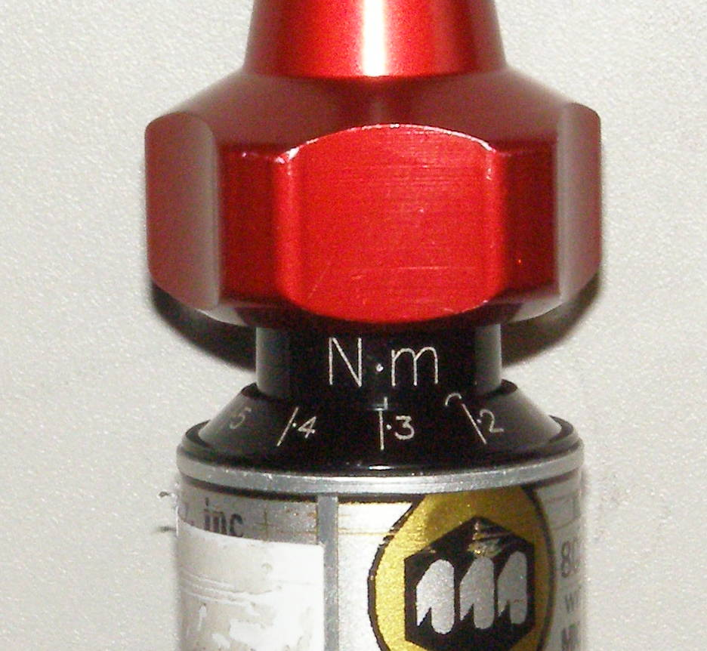
Robot Overview
Torque Drivers
0.8 Nm
2.0 Nm
3.17 Nm
6.34 Nm

Slide 7
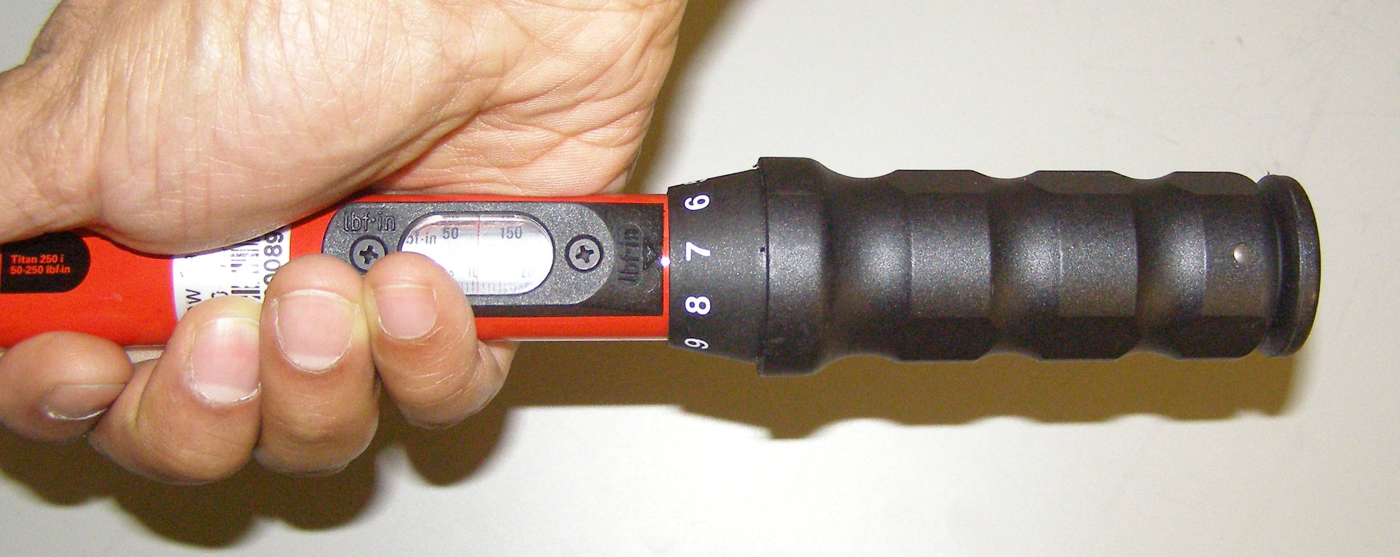
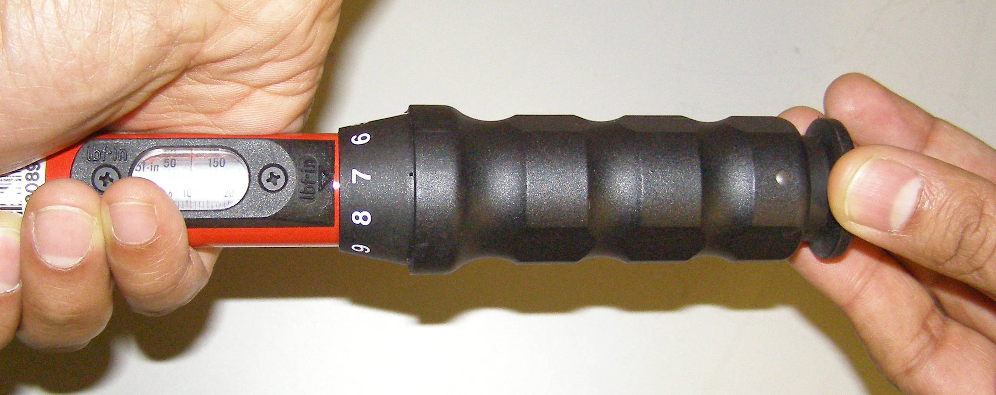
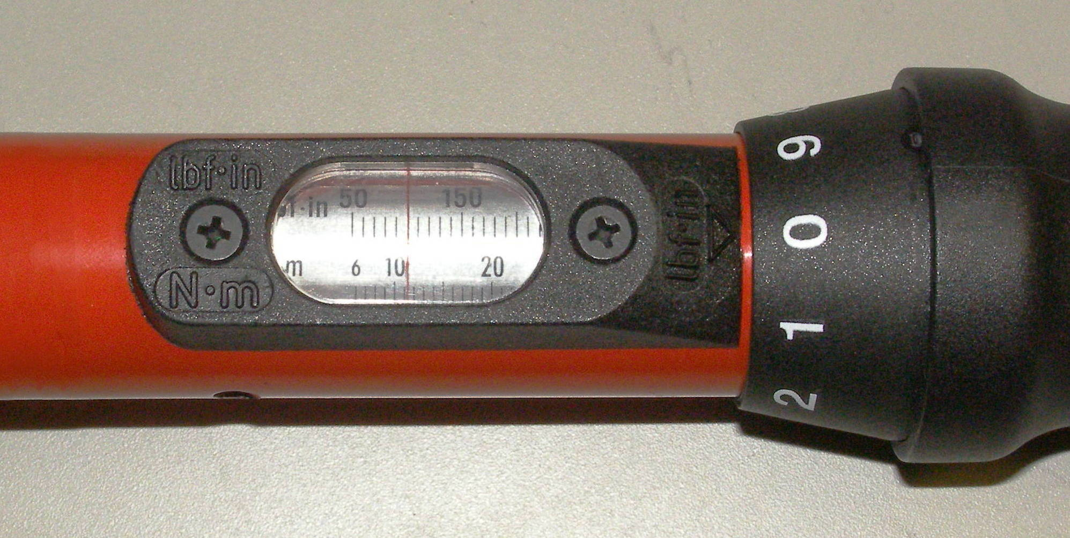
Robot Overview
Titan Torque Wrench
Adjustment locked
Adjustment unlocked
Rotate
11.0 Nm

Slide 8
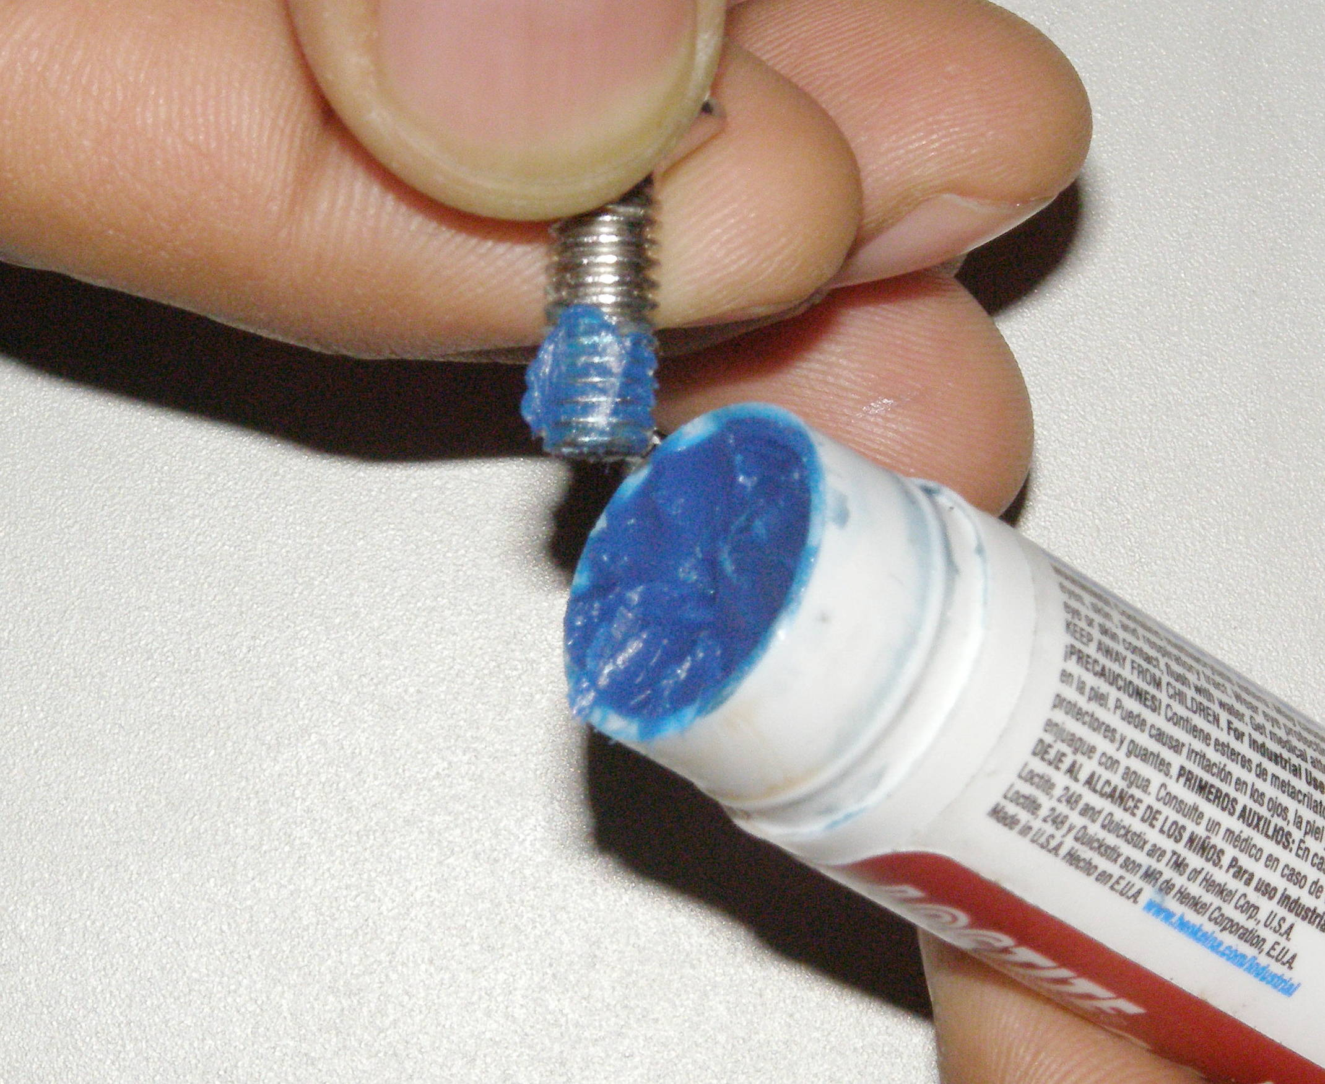
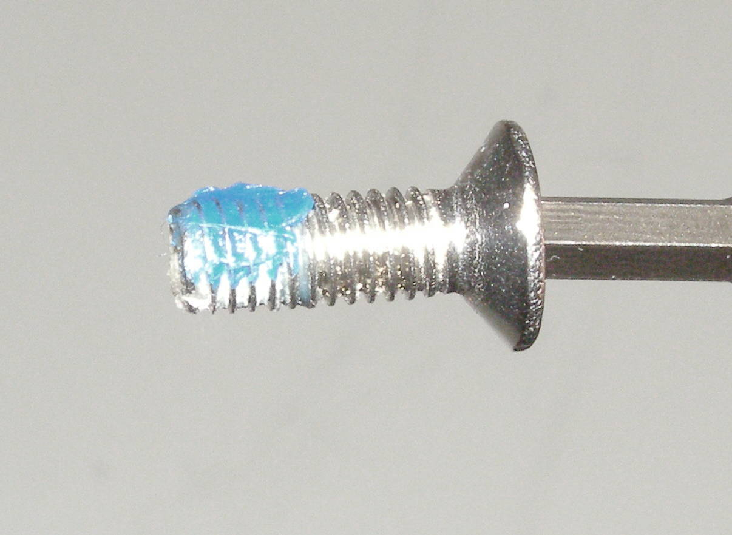
Robot Overview
Loctite
Only a small “Patch” of Loctite is needed.
Old Loctite.

